Slide 1
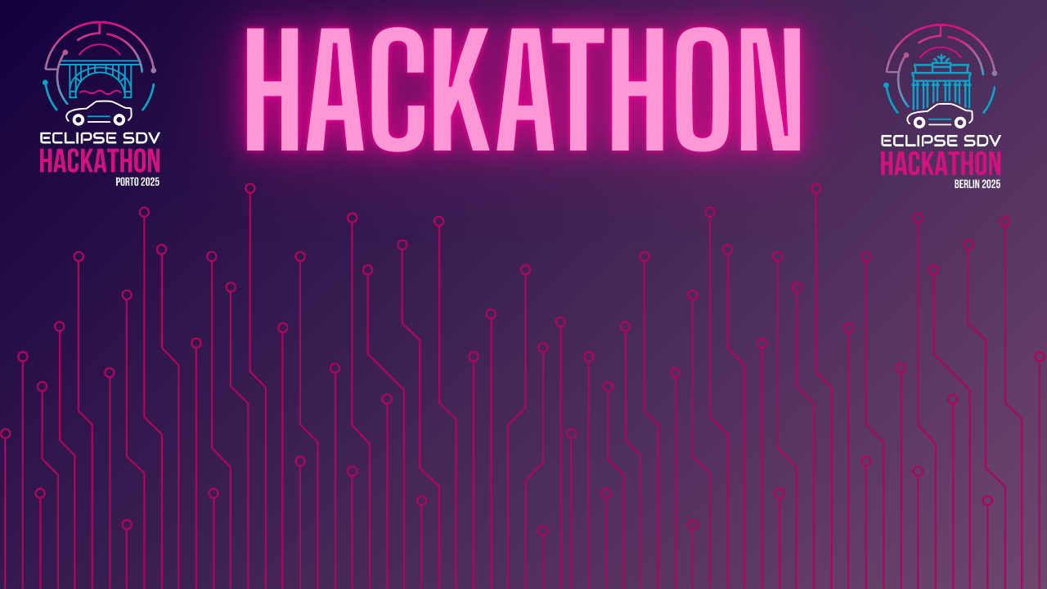

Chapter III - 2025
COPYRIGHT (C) 2025, ECLIPSE FOUNDATION

Slide 2
PITCHING SESSION STEERING INTO CODE
COPYRIGHT (C) 2025, ECLIPSE FOUNDATION

Slide 3

The Plan
Traffic accidents often happen due to drivers exceeding speed limits or not noticing changing traffic conditions. Even experienced drivers can miss signs, especially in busy urban environments.
Our goal is to develop a Smart Cruise Control (SCC). This system detects road signs in real time to adjust cruise control speed, with a map-based backup in case sign detection fails. From the information gathered is able to inform or make decisions regarding the speed of the car depending on what settings the user prefers.

Slide 4
Team and Structure
João Rema – Team Leader
Daniela Padilha – Developer and Team planning
Gabriel Aguiar – Debugger and Tester
Daniel Silva – Eclipse Tool Researcher
Rafael Castro – Project Structuring and Developer

Slide 5
The Product / Service
Detects traffic signs such as speed limits.
Sends this information instantly via uProtocol to the cruise control module.
Adjusts vehicle speed smoothly and safely in response.
We implemented this in the CARLA simulator, allowing us to test the vehicle in realistic urban environments with multiple traffic scenarios.
The system is modular, so it can be extended to real vehicles or more complex autonomous driving scenarios in the future.

Slide 6
The Added Value
The added value of our solution is enhanced safety and convenience:
Reduces the risk of accidents caused by missed speed signs;
Supports smoother traffic flow, reducing sudden braking or acceleration;
Provides a foundation for further autonomous driving features, such as adaptive braking or emergency interventions;
It’s a flexible, scalable system that can integrate with existing autonomous vehicle platforms.

Slide 7
The Market & The Competition
The autonomous vehicle and ADAS (Advanced Driver Assistance Systems) market is growing rapidly, with a global valuation of tens of billions of dollars.
Current competitors include proprietary solutions from car manufacturers, but most focus on physical vehicle sensors and lack modular open frameworks for simulation and rapid prototyping.
Our solution leverages open-source tools like CARLA and uProtocol, making it easy for research, prototyping, and hackathon-ready demonstrations, which sets us apart from traditional systems

Slide 8
Business Model * Plan & Funds
Our business model focuses on B2B and licensing for prototyping tools:
Sell modular software solutions to automotive startups, research labs, or universities for autonomous vehicle testing,
Potentially license the software to car manufacturers to accelerate their autonomous driving testing cycle.”
Offer consulting and integration services for companies wanting to quickly test ADAS features in simulation,

Slide 9
Plan & Funds
Our development plan is divided into three phases:
Prototype phase – build the functional traffic sign detection and cruise control simulation (completed in this hackathon),
Integration phase – connect the system with additional modules such as obstacle detection, lane keeping, and real vehicle interfaces,
Scaling phase – optimize performance and provide enterprise-ready solutions for clients.
Funding would mainly support software development, cloud resources for simulations, and developer salaries. In the long term, we aim for a combination of grants, partnerships with research institutions, and B2B licensing revenue.

Slide 10
Contact
In conclusion, our Smart Cruise Control system demonstrates a modular, scalable approach to autonomous vehicle safety, capable of reacting in real time to traffic signs.
We combine simulation, real-time communication, and intelligent control to create a product that is both safe and extensible.
Our solution addresses a growing market, offers clear added value over competitors, and provides a realistic business model for sustainability.
We are excited to continue development beyond the hackathon and explore full integration with real vehicles.
Thank you for your attention, and we are happy to answer any questions.

Slide 11
Thank You slide
Thank your audience and encourage them to get in touch afterwards.
COPYRIGHT (C) 2025, ECLIPSE FOUNDATION

